Slide 1
Biomaterials
Autumn 2022
(Source Biomaterials Science by Buddy Ratner, 3rd edition)

Slide 2
Definition of Biomaterials:
The most accepted deﬁnition of biomaterials is currently the one employed by the American National Institute of Health:
‘‘Any substance or combination of substances, other than drugs, synthetic or natural in origin, which can be used for any period of time, which augments or replaces partially or totally any tissue, organ or function of the body, in order to maintain or improve the quality of life of the individual’’.

Slide 3
Polymer | Initial Use | Medical Use
Polyether Urethane | Ladies Girdles | Artificial heart
Cellulose Acetate | Suasage Casing | Dialysis Tubings
Dacron | Cloting | Vascular Graft, dialysis membrane
Silicone | Lubricant | Cadiac valve, extracorporeal machine tubing, coatings, Breast Implants
Polyurethane | Matress Stuffing | pacemaker lead insulation, artificial veins and arteries, catheters

Slide 4
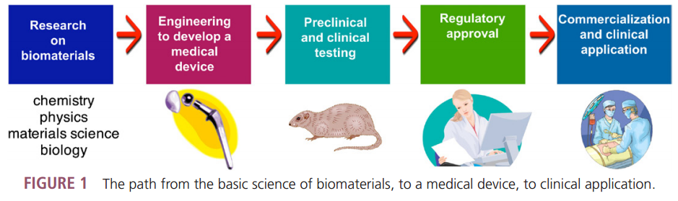
Path of biomaterials from laboratory to application

Slide 5
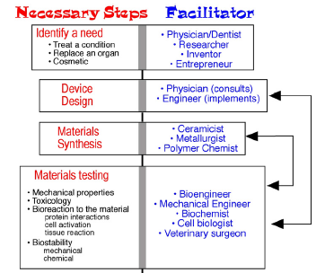
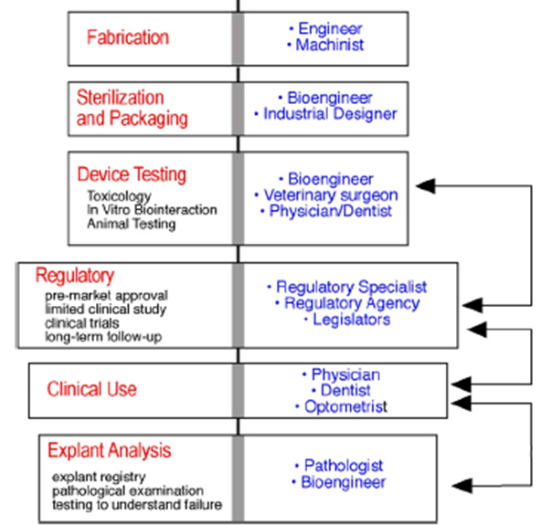
Biomaterials Science is an Multi-disciplinary Field

Slide 7
Hip prosthesis
alumina-zirconia
titanium alloy
The human hip joint is subjected to high levels of mechanical stress, and receives considerable abuse in the course of normal and extraordinary activity.
Hip joint prostheses are fabricated from a variety of materials, including titanium, stainless steel, special high-strength alloys, ceramics, composites, and ultrahigh molecular weight polyethylene (UHMWPE).
polyethylene
In most cases, good function is restored. Even athletic activities are possible, although those activities that subject the repaired joint to high stress are generally not advisable.
After 10–15 years, many of these implants fail by loosening, which usually necessitates another operation (a revision procedure).
Metal-on-metal implants also experience problems of corrosion and adverse responses to released metal ions.

Slide 8
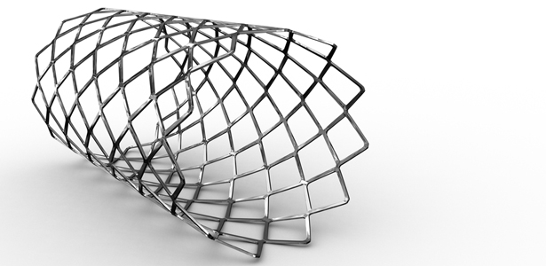

Slide 9
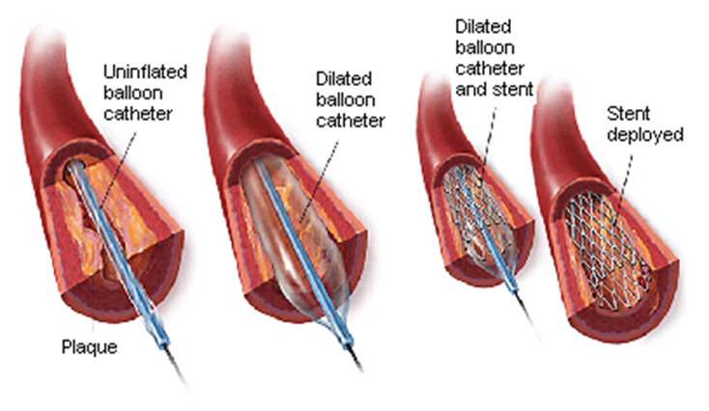
Stents
A stent is a mesh 'tube' inserted into a natural passage/conduit in the body to prevent or counteract a disease-induced, localized flow constriction
In cardiology, the treatment of coronary artery disease has long been limited to bypass surgery to circumvent the stenotic region. With this technique, veins are taken for example from the patient’s legs and used to bypass the narrowed region, thus re-enabling blood flow. Such a treatment represents a significant burden for the patient, and one of the most intriguing aspects of modern medical technologies is the opportunity to reduce both patient burden and treatment costs by using minimally invasive methods.
The stents may be made from different materials, and are mounted on the balloon which, when inflated, also inflates the stent; this occurs when a stainless steel stent is used. Alternatively, the stent may self-expand when it is released from the delivery system; this occurs when a stent is made from Nitinol, an alloy made from nickel and titanium.

Slide 11
Prosthetic heart valves
Diseases and degeneration of the heart valves often make surgical repair or replacement necessary. The natural heart valve opens and closes over 40 million times per year, and can require replacement due to disease or wear.
They are fabricated from carbons, metals, elastomers, plastics, fabrics, and animal or human tissues chemically pretreated to reduce their immunologic reactivity, and to enhance durability.
Good Success rate: Generally, as soon as the valve is implanted, cardiac function is restored to near normal levels, and the patient shows rapid improvement.
In spite of the overall success seen with replacement heart valves, there are problems, many of them specific to a specific type of valve; they include induction of blood clots, degeneration of valve tissue leaflets, mechanical and infection.
Mechanical heart valve
Xenograft

Slide 12
Dental root form implants
These devices form an implanted artificial tooth anchor upon which a crown is affixed
A special requirement of a material in this application is the ability to form a tight seal against bacterial invasion where the implant traverses the gingiva (gum)
Schematic images of early dental root form implants and a photograph of several designs used in clinical practice
Other issues are associated with the rapidly growing junctional epithelium inhibiting regrowth of the slower growing bone.
Loss of tissue support leading to loosening remains an occasional problem, along with infection and issues associated with the mechanical properties of unalloyed titanium that is subjected to long-term cyclic loading.

Slide 13
Intraocular lenses
Implants to replace lenses in the eye that have clouded due to cataracts are called intraocular lenses (IOLs).
By the age of 75, more than 50% of the population suffers
from cataracts severe enough to warrant IOL implantation.
They have been fabricated from a variety of transparent materials including poly(methyl methacrylate), silicone elastomer, soft acrylic polymers, and hydrogels.
Good vision is generally restored almost immediately after the lens is inserted, and the success rate with this device is high.
Two styles of multipiece intraocular lenses.
Outgrowth of cells onto the IOL from the posterior lens capsule, stimulated by the presence of the IOL, can cloud vision, and this is a significant complication.

Slide 14
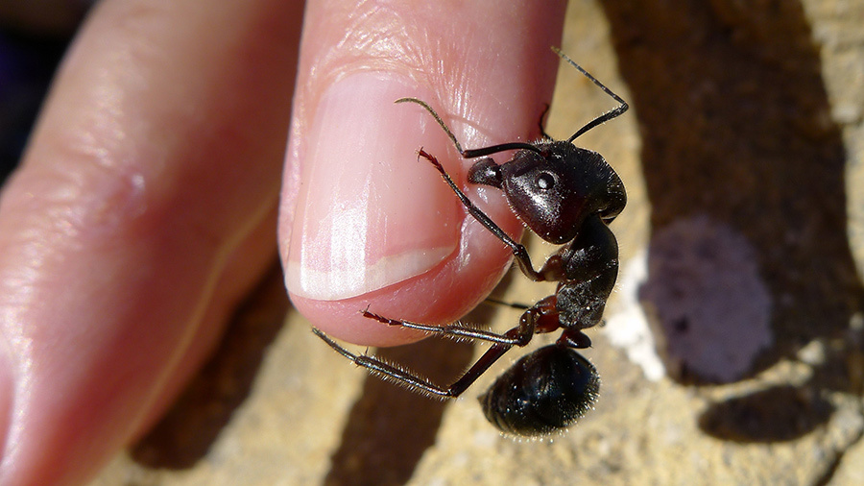
Assignment –
Read this article and write one paragraph summary
11 BIOMATERIALS THAT CAN HEAL THE HUMAN BODY. INCLUDING, YES, BITING ANTS.
http://ideas.ted.com/2014/02/18/a-history-of-biomaterials/

